Slide 1

System Architecture Design

Slide 2
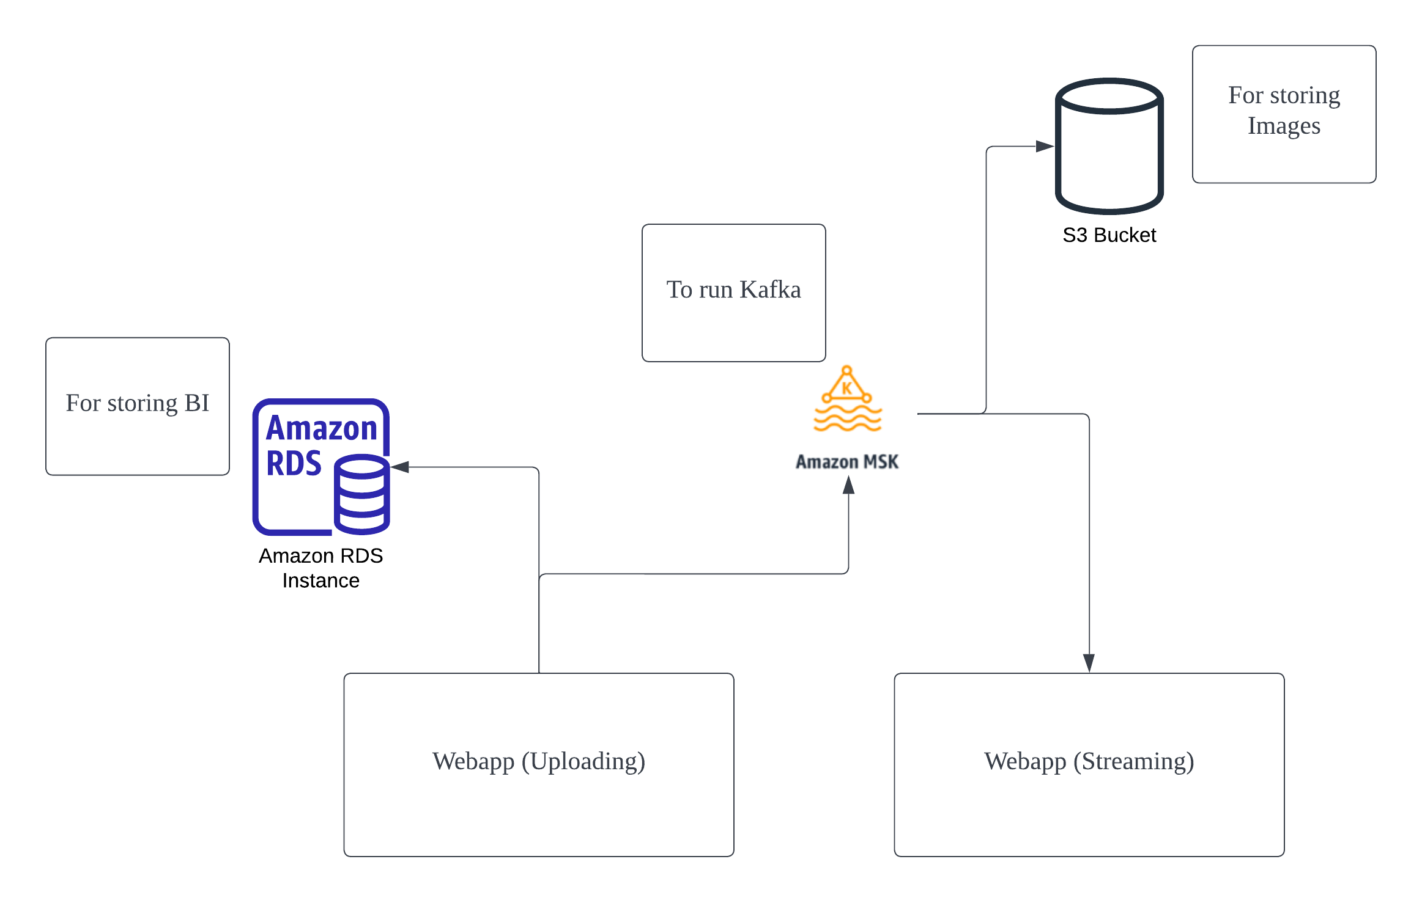
Overview

Slide 3
Amazon Managed Streaming for Apache Kafka (MSK)
Allows reuse of current Kafka stream and code to process images
Eliminates operational overhead
Easily scale cluster capacity
Lower cost, pay-as-you-go pricing
Direct stream to streaming webapp as well as S3 bucket

Slide 4
Amazon RDS
Allows capture of structured information for BI purposes from the upload application
Fully managed with automated scaling
Secure and highly available
Good performance at scale

Slide 5
Amazon S3 bucket
Object storage to store images
Scalable to meet needs of business
Low cost
Able to remove data automatically after 7 days

Slide 6
AWS
Pros | Cons
User-Friendly | AWS service limits
Flexible (Supports different OS, programming languages, etc.) | Learning Curve
Secure | Technical support fee
Cost Effective | Cloud computing glitches
Reliable
Scalable

Slide 7

Thank you

